Slide 1
Putting a Bow on 2021
and Opening the Box to 2022
December 2021

Slide 2
Outline
Inflation
Value / Growth
2022 Outlook

Slide 3
Capital Investment Advisors – 25th Anniversary
Notes:
Levi is two and you have another one coming…not sure you want to announce that on webinar but we could have a Two theme here

Slide 4
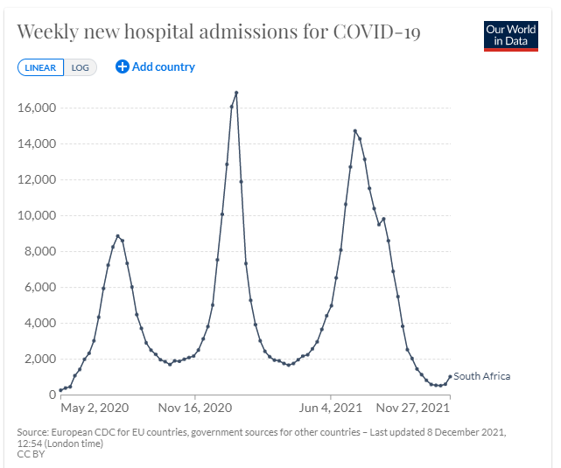
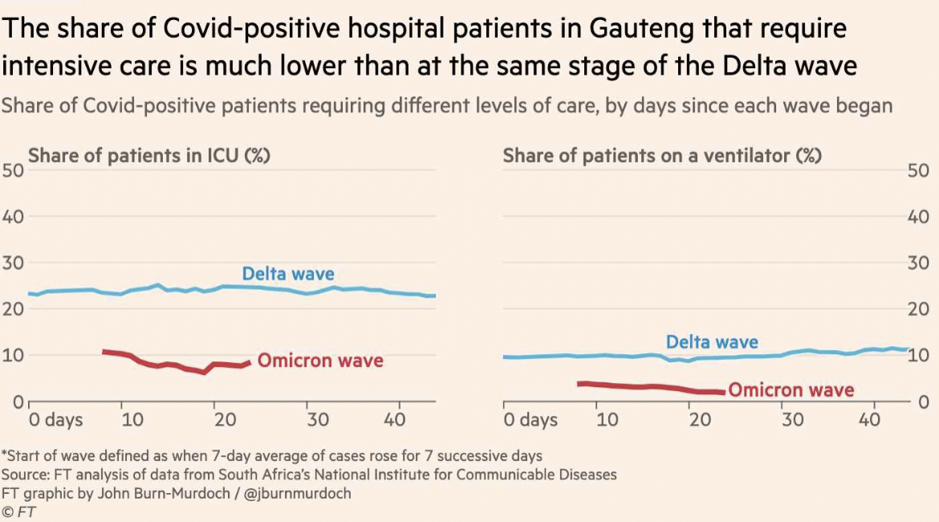
COVID Update

Slide 5
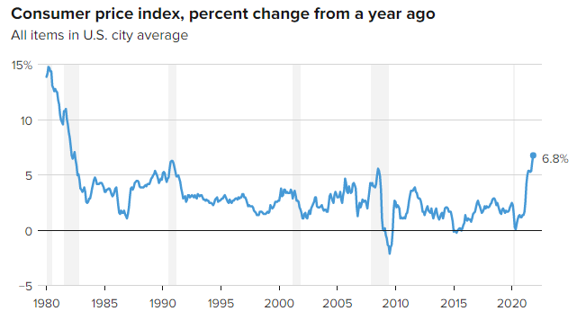
Inflation – Consumer Price Index
Source: Bureau of Labor Statistics
Data as November 2021

Slide 6
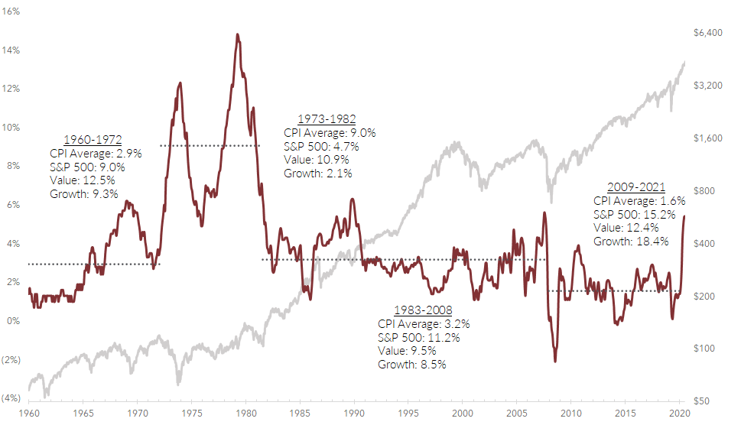
Elevated CPI Has Been Good News For Value
Can we do a graphic here where G>>V?
Source: Bloomberg
Data as of October 31, 2021

Slide 7
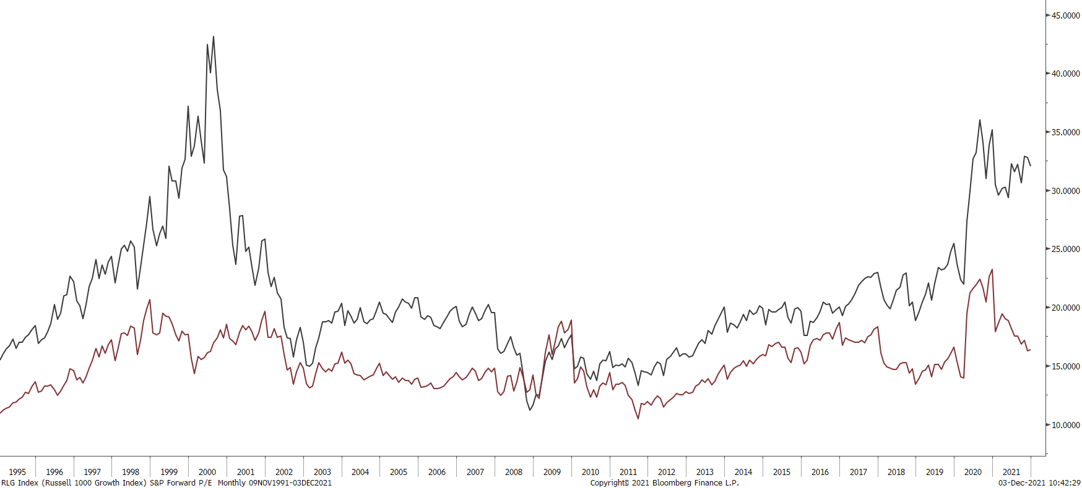
Value vs. Growth
Russell 1000 Growth P/E
Can we do a graphic here where G>>V?
Russell 1000 Value P/E
Source: Bloomberg
Data as of October 31, 2021

Slide 8
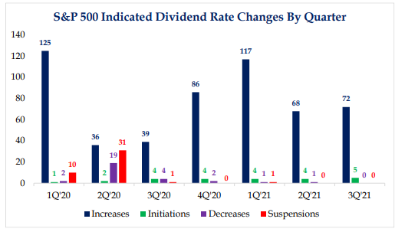
Income – We Continue to Like Dividends
Source: Strategas

Slide 9
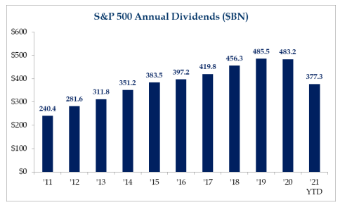
Income – We Continue to Like Dividends
Source: Strategas

Slide 10
Dividend List
Ticker | Company | Sector | Dividend Yield | Forward P/E
BBY | Best Buy Co., Inc. | Consumer Disc. | 2.6% | 11.8x
CAH | Cardinal Health, Inc. | Health Care | 4.1% | 8.2x
CMI | Cummins, Inc. | Industrials | 2.6% | 13.3x
CSCO | Cisco Systems, Inc. | Information Technology | 2.5% | 16.6x
GILD | Gilead Sciences, Inc. | Health Care | 4.1% | 10.3x
HII | Huntington Ingalls Ind. | Industrials | 2.6% | 13.9x
LMT | Lockheed Martin Corp. | Industrials | 3.3% | 12.7x
NEM | Newmont Corporation | Materials | 3.9% | 18.5x
PFE | Pfizer, Inc. | Health Care | 3.0% | 10.8x
SNA | Snap-on, Inc. | Industrials | 2.7% | 14.3x
Average |  |  | 3.1% | 13.0x
SPX |  |  | 1.3% | 21.7x
*This is provided for illustrative purposes only. Might not be reflective in actual portfolios.
Dividend Yield and Forward P/E as of December 7, 2021

Slide 11
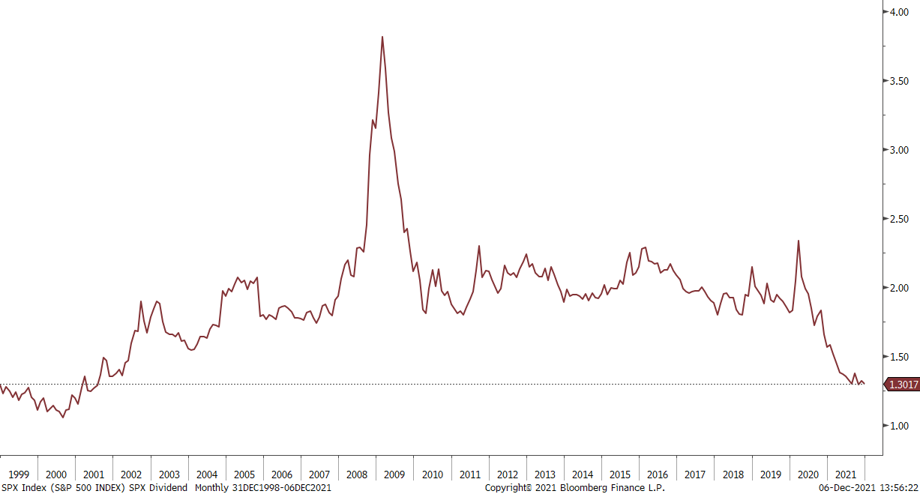
Dividend Yield
Source: Bloomberg
Dividend Yield as of December 6, 2021

Slide 12
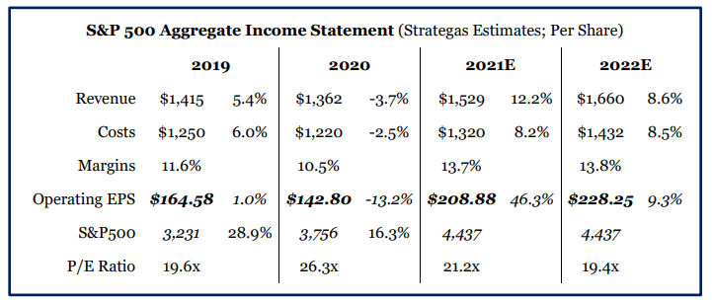
Looking Into 2022
Source: Strategas

Slide 13
Looking Into 2022
Inflation is here to stay in a meaningful way.
We believe dividend paying stocks that have the ability to increase revenues to combat rising costs is your best bet vs. bonds and cash in a portfolio. Look for us to allocate towards more inflation-protected industries, sectors and stocks.
Tech is overweight and overvalued.
We continue to stay patient and disciplined with our approach looking for stocks that are cheap/undervalued in the market that pay dividends and consistently grow their dividends. We think these companies are better positioned to navigate any market headwinds.
Interest rates should rise to combat inflation.
This should confirm our investments in income investments.

Slide 14
Disclosure
This information is provided to you as a resource for informational purposes only. Information presented herein is provided to you as a guideline for general information and might not be applicable to your individual situation. Investing involves risk, including the possible loss of principal. There is no guarantee offered that investment return, yield, or performance will be achieved. There will be periods of performance fluctuations, including periods of negative returns. Past performance is not indicative of future results when considering any investment vehicle. The mention of any company is provided to you for informational purposes and as an example only and might not be suitable to your specific situation. This information is being presented without consideration of the investment objectives, risk tolerance, or financial circumstances of any specific client and might not be suitable for all clients. As always, talk to your investment advisor about your specific situation and/or to notify us should any changes arise in your financial situation or investment objective.

